Slide 1
Air Quality Project
Assignment 4: More on Openair
Notes:
Use all of these slides only as necessary when you want to discuss a certain plot with the class. E.g. a question comes up about polar plots, pull up the polar plot slides and walk through it for everyone. Show the agenda slide though to explain the activity

Slide 2
Today’s Agenda
As a group, you’ll make several standard and advanced plots with openair using your data. By the end of class, you should have decided what you think your 3 most important or useful figures with regards to your research about your site are.
The slides will summarize the information about each figure, and provide larger versions of example plots. You may also want the openair manual: https://bookdown.org/david_carslaw/openair/

Slide 3
Aside: Goal for this week
The goal for this week is to get ready for your group's preliminary presentation on Friday, specifics of which can be found in Air Quality Project Assignment #5 on Canvas.
Here is our schedule for the week:
Day | In Class | Submit
Monday | More on Openair | Openair tutorial
Wednesday | Group work | Research question
Thursday | Group work | One polished figure
Friday | Preliminary Presentations | Slides in class deck

Slide 4
Setup
You’ll need the openair and tidyverse libraries today (as well as any more you wish to add)
library(openair); library(tidyverse);
Then import your data to operate on it:
dat <- importAURN(site = "my1", year = 2000:2005);
Remember that your plots should be based on the data from your team’s Germany site.

Slide 5
Work as a team and at your own pace
You'll find lots of plot options in the google doc that goes with Assignment #4. Browse through these and play around with your data and the options.
Then pick three figures that you believe best support your research question.
You DO NOT have to try all provided plot options. Rather, think first what might be the most interesting and useful for your particular dataset.

Slide 6
Wind Rose
Uses (and Sources):
Summarizes the frequencies of winds of various velocities at a single location.
(Air Pollution Control Engineering)
Data Columns Required:
Wind Direction (wd)
Wind Speed (ws)
Date/Time (date)

Slide 7
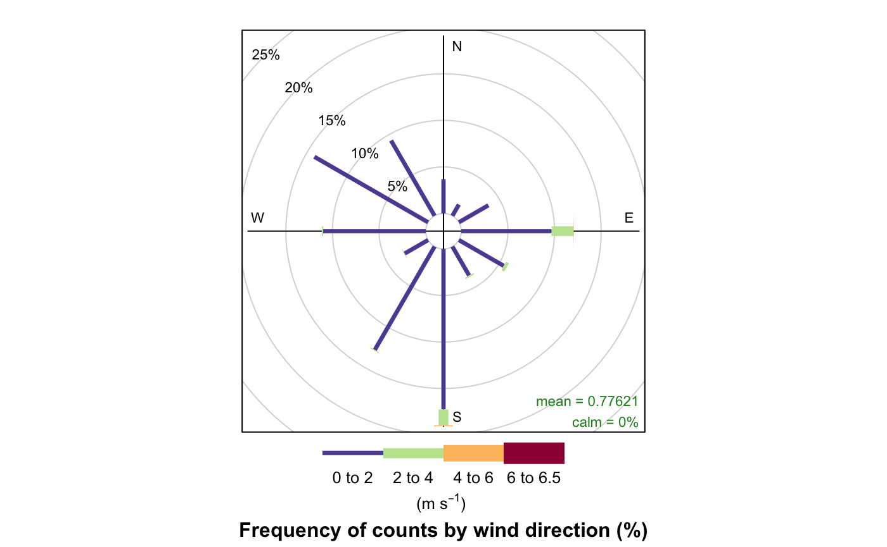
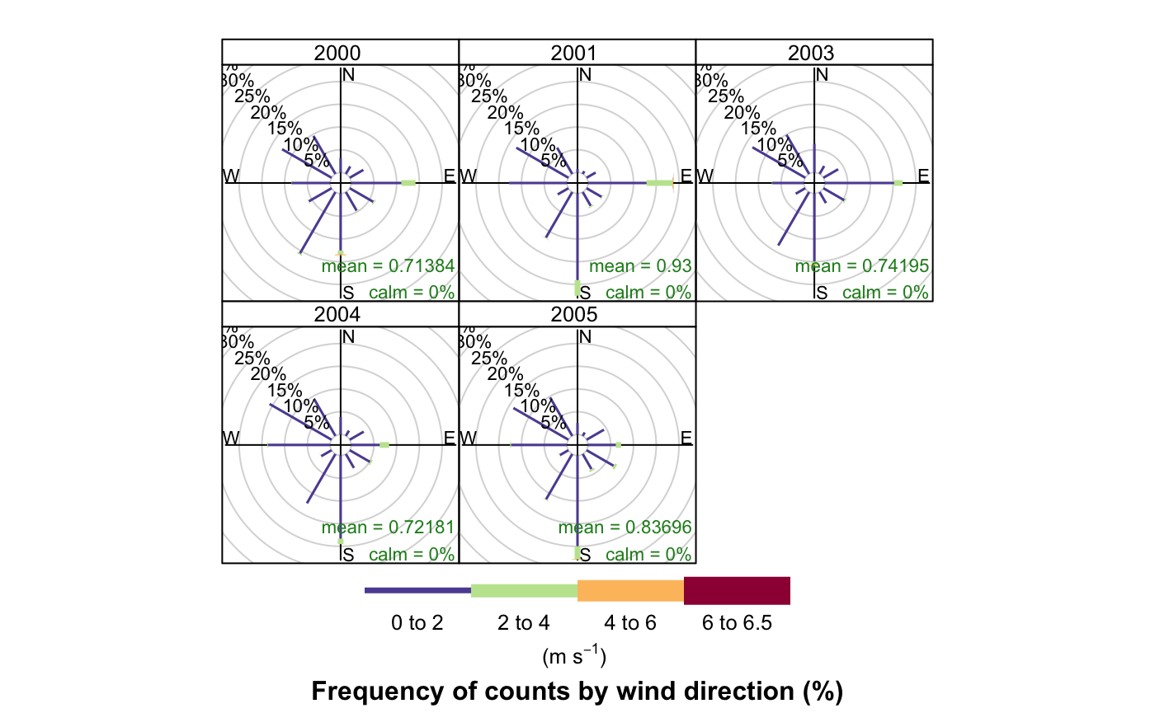
Wind Rose Examples

Slide 8
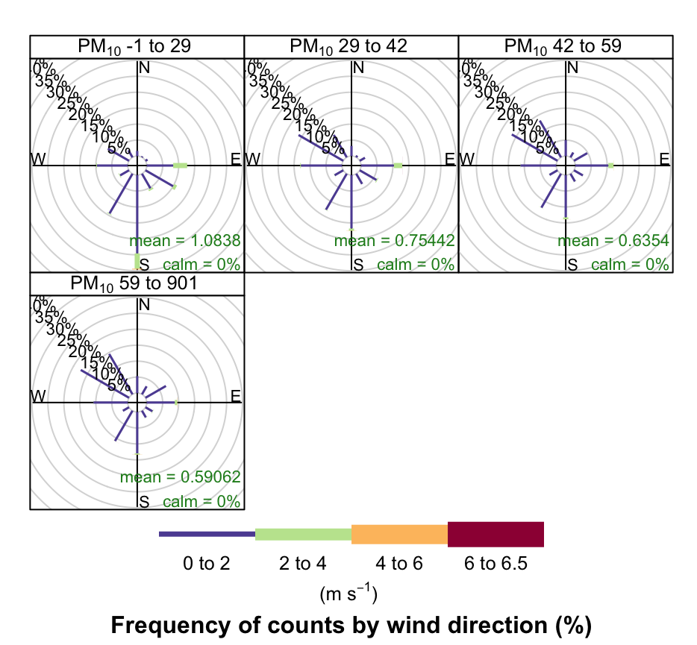
Wind Rose Examples

Slide 9
Pollution Rose
Uses (and Sources):
Summarizes the levels of pollutants associated with certain wind directions.
(Source Region ID using Kernel Smoothing)
Data Columns Required:
Wind Direction (wd)
A Pollutant (e.g., pm10)
Date/Time (date)

Slide 10
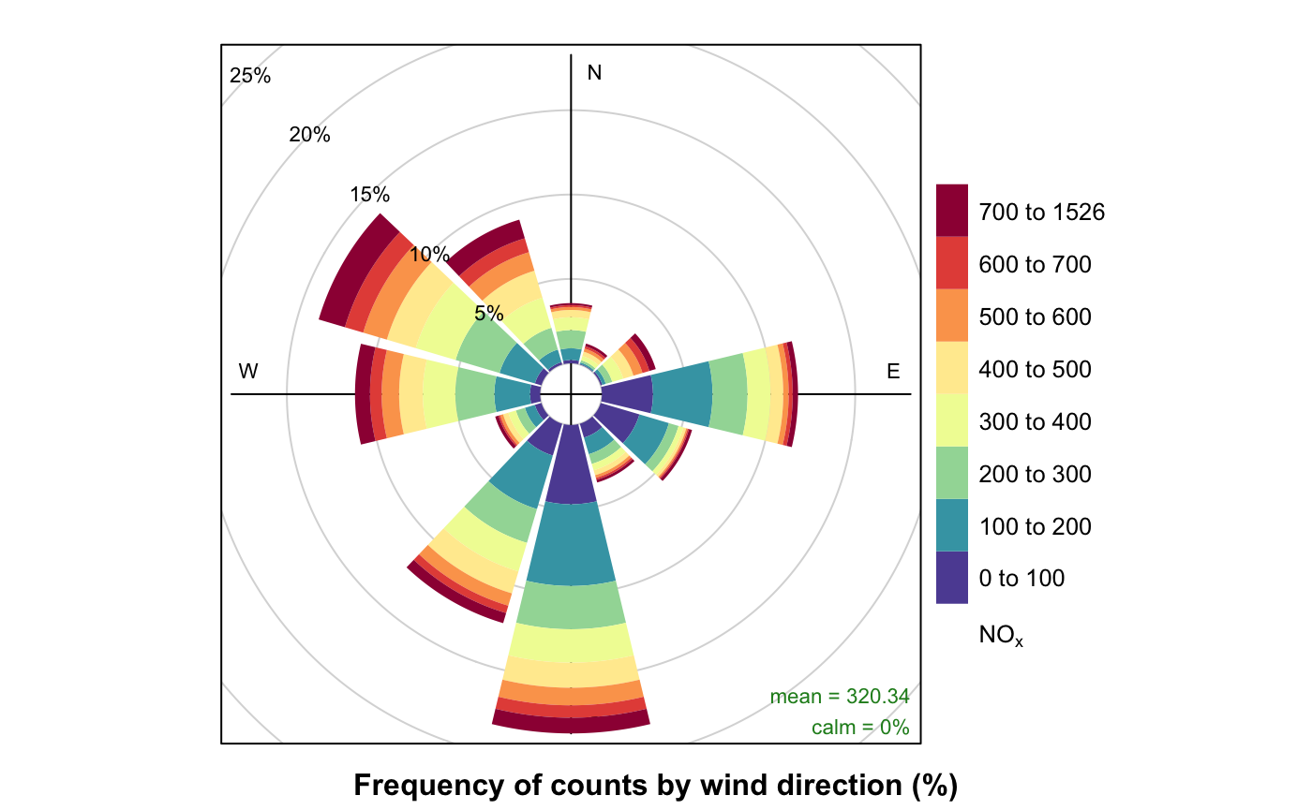
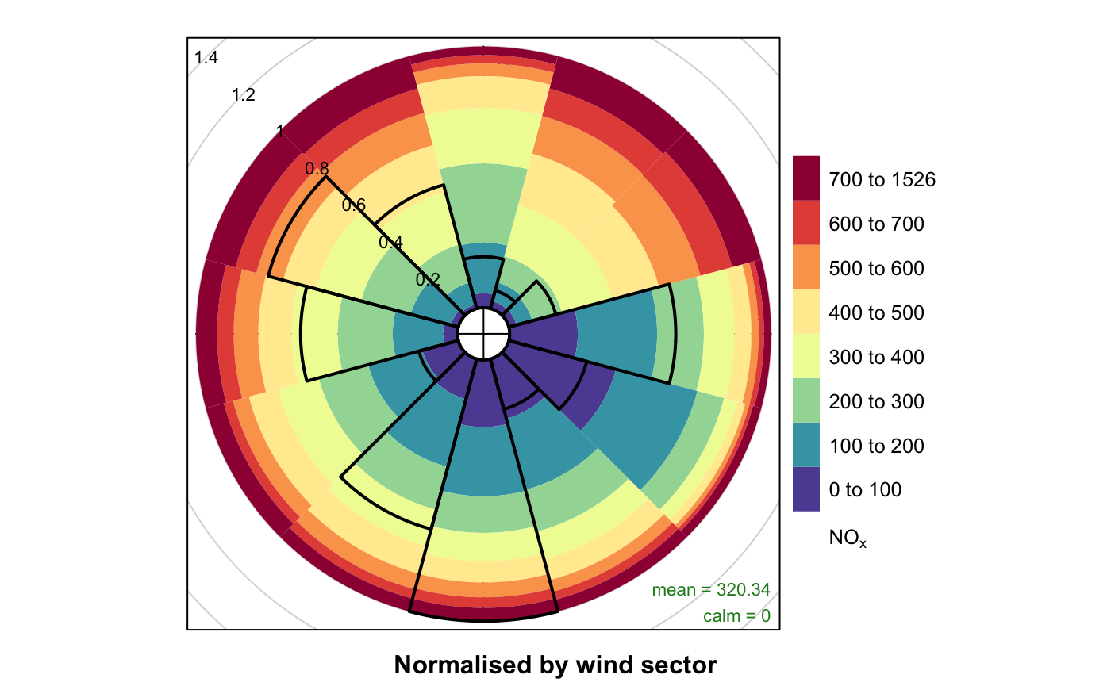
Pollution Rose Examples

Slide 11
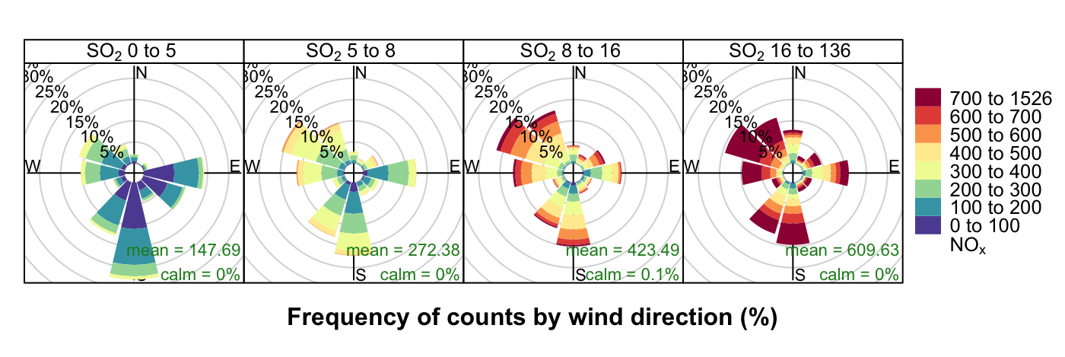
Pollution Rose Examples

Slide 12
Polar Frequencies
Uses (and Sources):
Summarizes wind speeds and directions by the number of hours a wind is in a certain speed and direction. Can also add pollution data.
(Polar Isopleths)
Data Columns Required:
Wind Direction (wd)
Wind Speed (ws)
A Pollutant (e.g., pm10)
Date/Time (date)

Slide 13
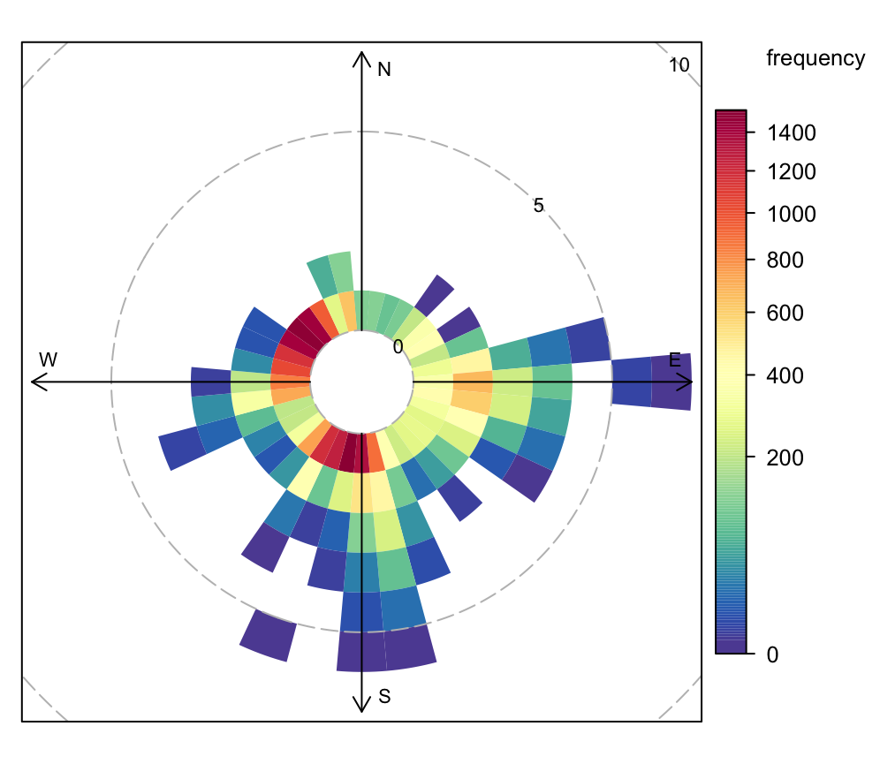
Polar Freq Examples

Slide 14
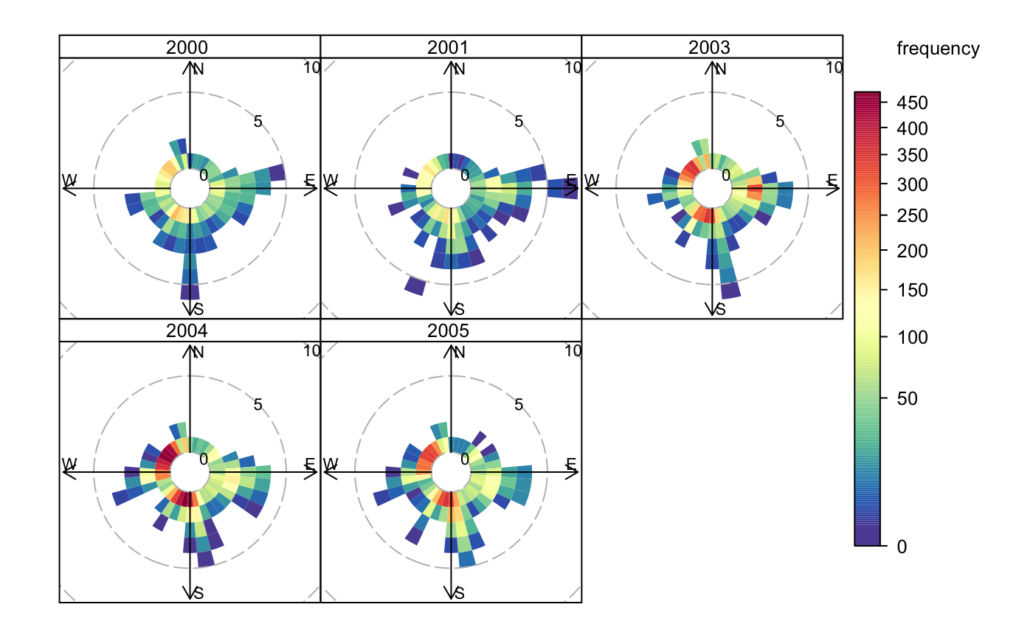
Polar Freq Examples

Slide 15
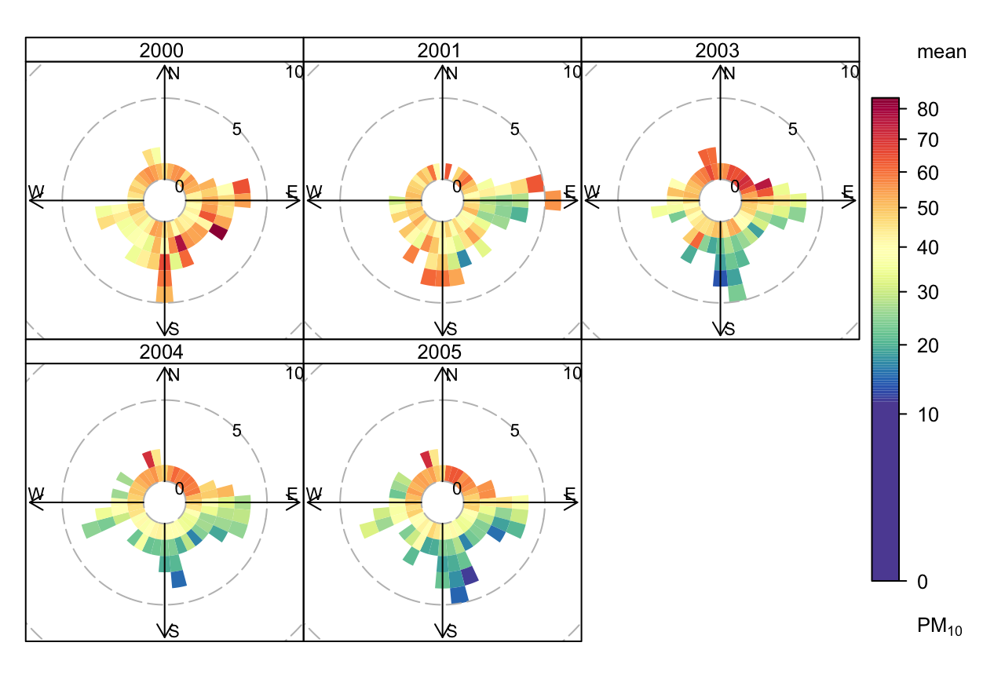
Polar Freq Examples

Slide 16
Percentile Rose
Uses (and Sources):
Summarizes pollutants tied to wind directions, most crucially shows the distribution of concentrations by direction.
Data Columns Required:
Wind Direction (wd)
Wind Speed (ws)
A Pollutant (e.g., pm10)
Date/Time (date)

Slide 17
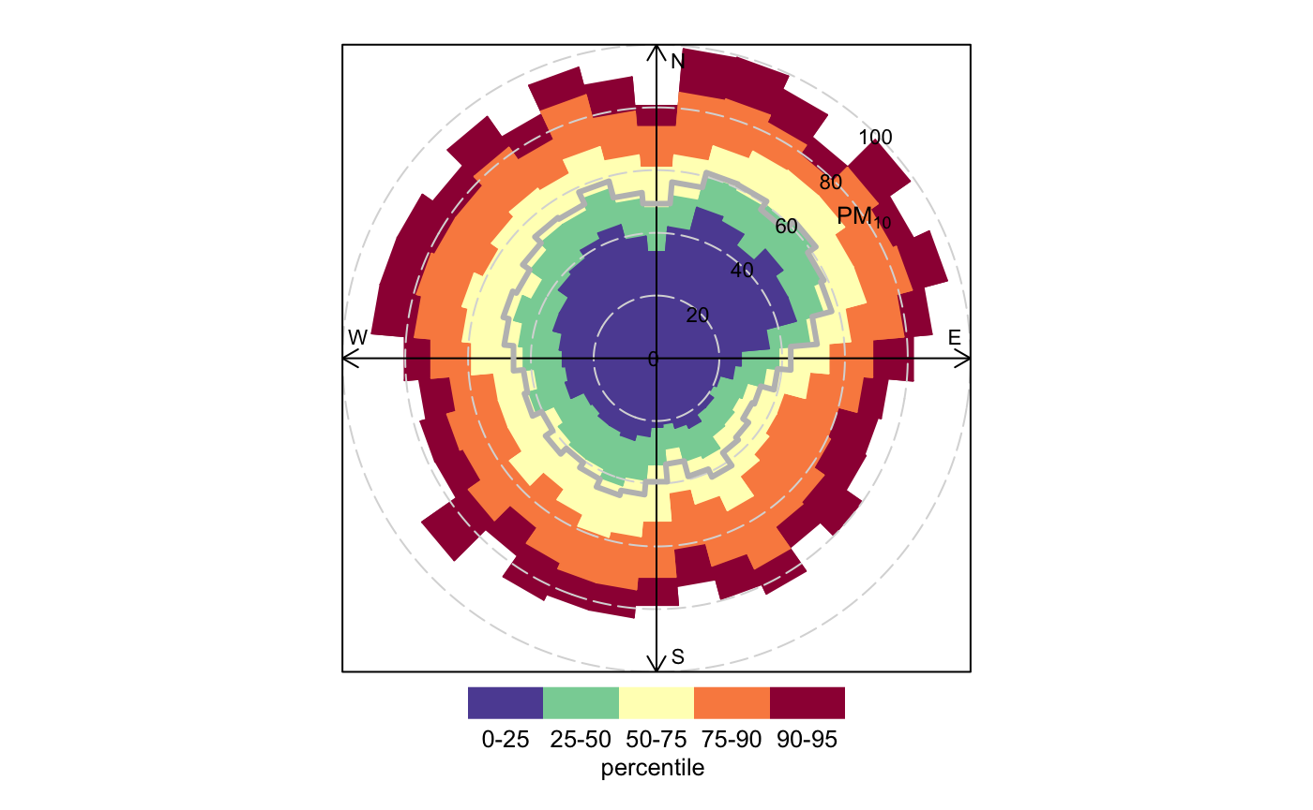
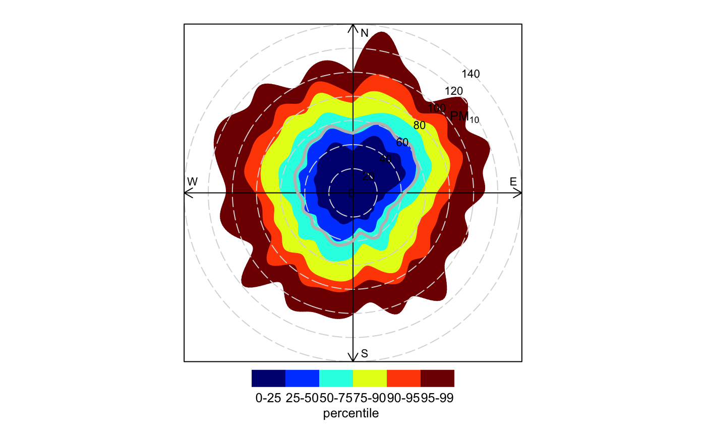
Percentile Rose Examples

Slide 18
Polar Plots
Uses (and Sources):
Shows the concentrations of a pollutant modeled on a wind speed surface, which can then be plotted on a map with a little work. Also can create a ratio variable of two pollutants and plot that. Shows wind speed dependence. (Analysis of air quality in a street canyon…)
https://www-sciencedirect-com.dartmouth.idm.oclc.org/science/article/pii/S1352231007006863?via%3Dihub
Data Columns Required:
Wind Direction (wd)
Wind Speed (ws)
A Pollutant (e.g., pm10)
Date/Time (date)

Slide 19
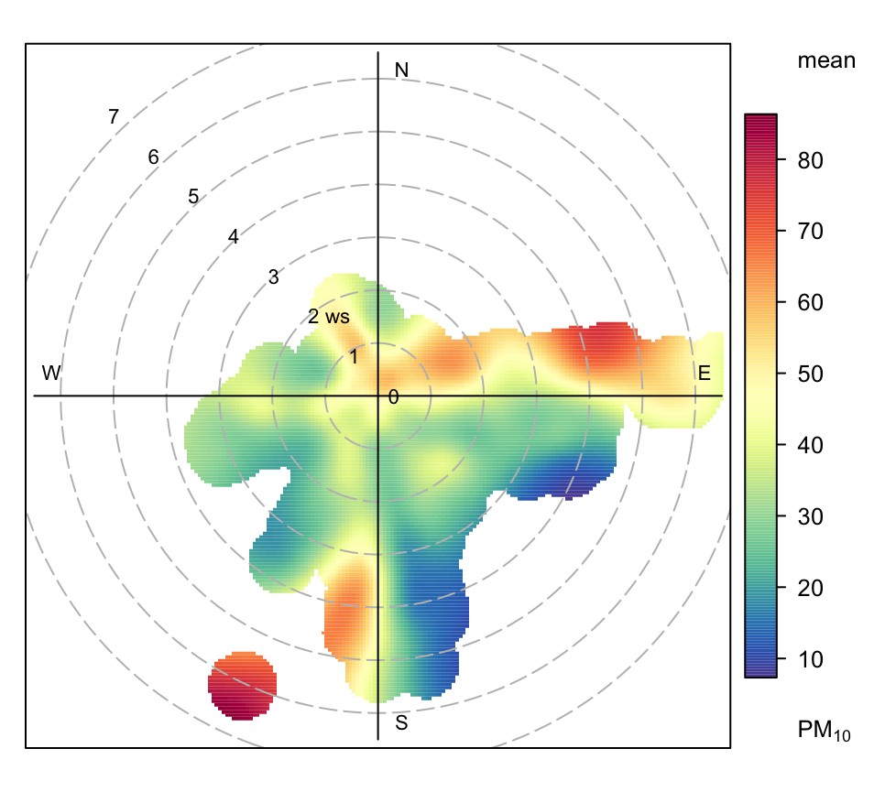
Polar Plot Examples

Slide 20
Polar Annulus
Uses (and Sources):
Plots an Annulus that shows changes in pollutant direction over time on different time scales.
Data Columns Required:
Wind Direction (wd)
Wind Speed (ws)
A Pollutant (e.g., pm10)
Date/Time (date)

Slide 21
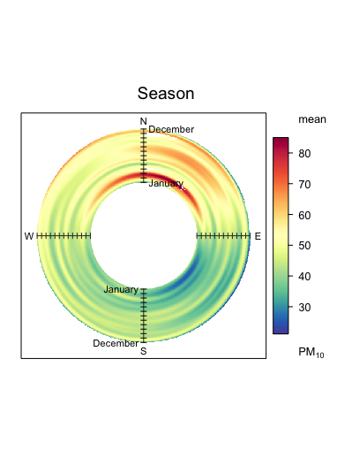
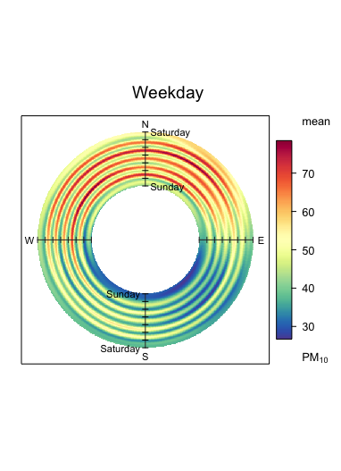
Polar Annulus Examples

Slide 22
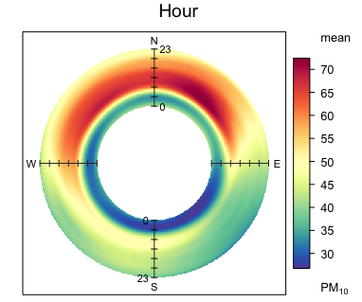
Polar Annulus Examples

Slide 23
Time Series Plot
Uses (and Sources):
Simply plots pollution level over time for the requested pollutants in the requested time frame. Averaging of values is also possible. Easily reveals data gaps if present.
Data Columns Required:
A Pollutant (e.g., pm10)
Date/Time (date)

Slide 24
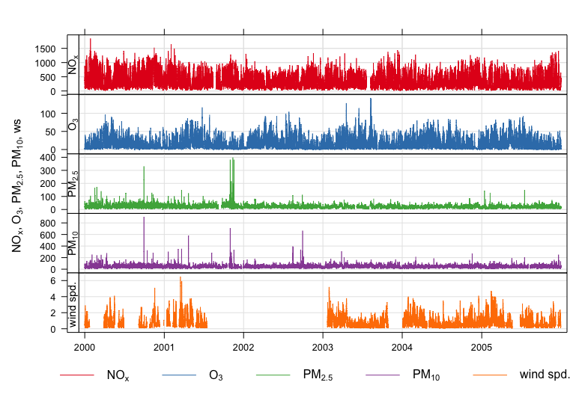
Time Series Plot Examples

Slide 25
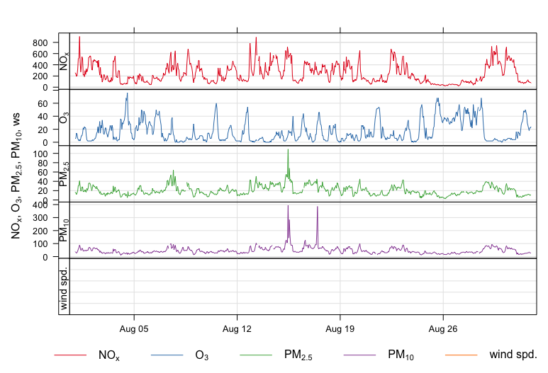
Time Series Plot Examples

Slide 26
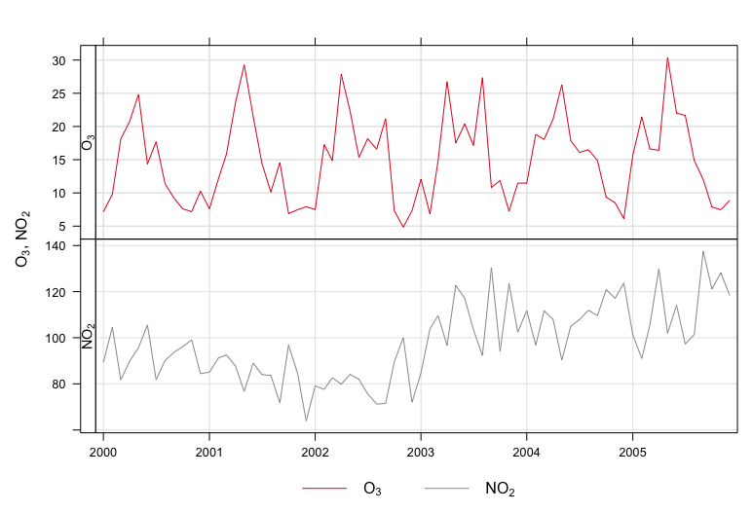
Time Series Plot Examples

Slide 27
Temporal Variation Plots
Uses (and Sources):
Plots pollution over time on several different scales, including a 95% CI of the mean (pink shading). Use in conjunction with polarPlot to find a ws/wd of interest and focus on that.
Data Columns Required:
A Pollutant (e.g., pm10)
Time/Date (date)

Slide 28
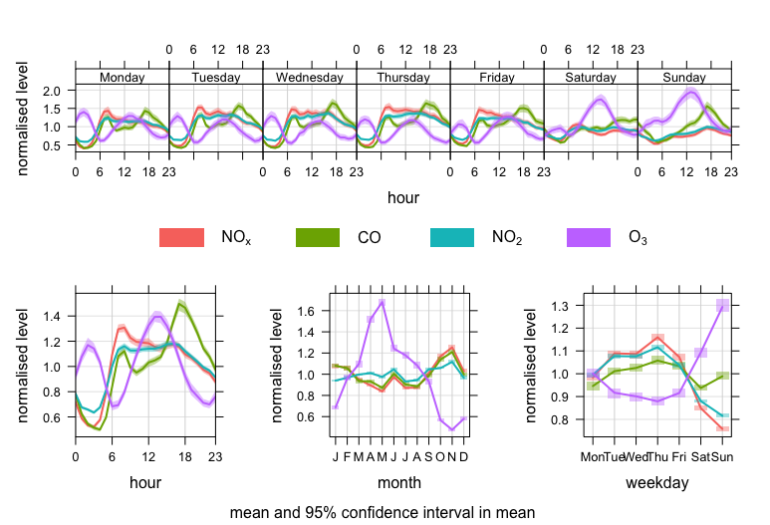
Temporal Var Examples

Slide 29
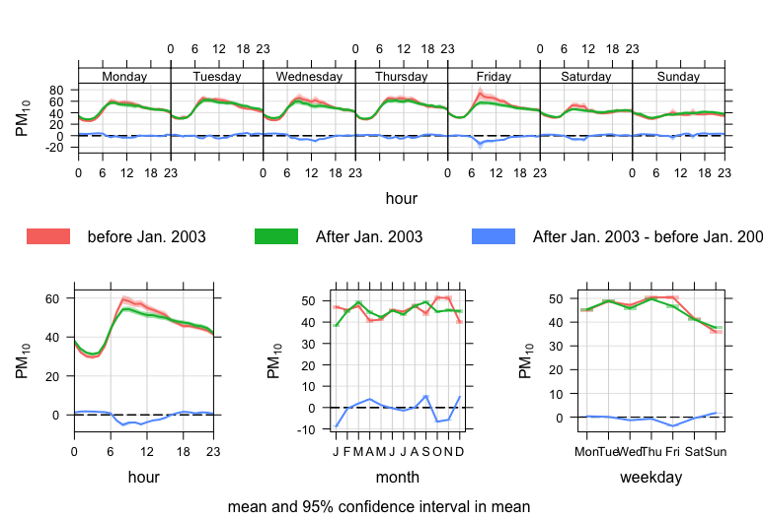
Temporal Var Examples

Slide 30
Time Proportion Plots
Uses (and Sources):
Shows the time series plots as stacked bar charts. Time series is averaged and broken down by the proportion contribution of another variable. Difficult to read with more than 3 or 4 contributions.
Data Columns Required:
Pollutant (e.g., pm10)
Date/Time (date)
Wind Speed (ws)
Wind Direction (wd)
Another Factor (...)

Slide 31
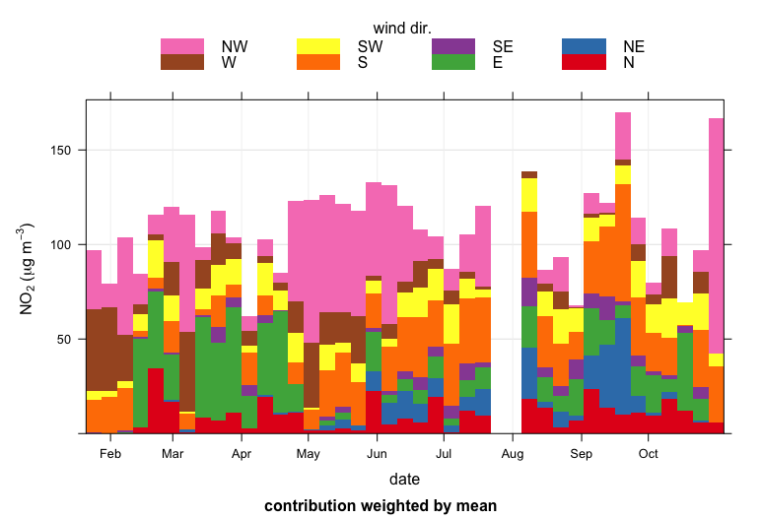
Time Prop Examples

Slide 32
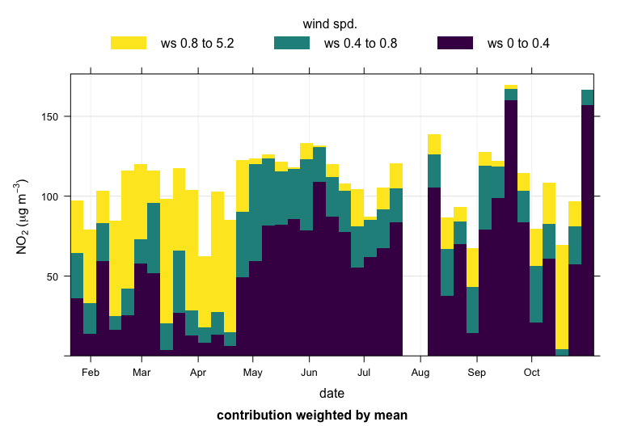
Time Prop Examples

Slide 33
Trend Level Heat Map
Uses (and Sources):
Creates a heat map of a pollutant on a field of two variables x and y, often grouped by year. Defaults to x = month and y = hour. Possible to modify many other ways.
Data Columns Required:
Date/Time (date)
A Pollutant (e.g., pm10)
Other factors
Ws
Wd
More pollutants

Slide 34
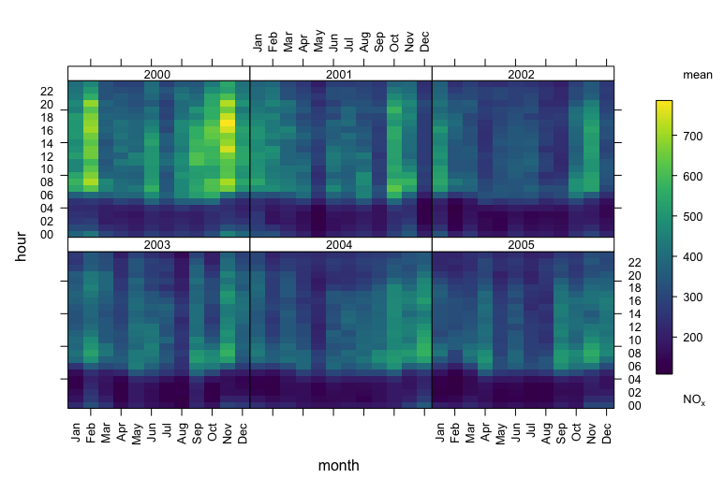
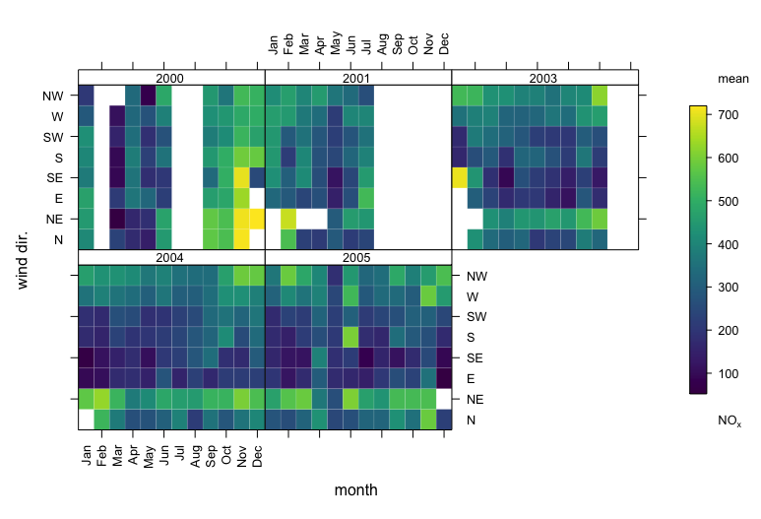
Trend Level Heat Map Examples

Slide 35
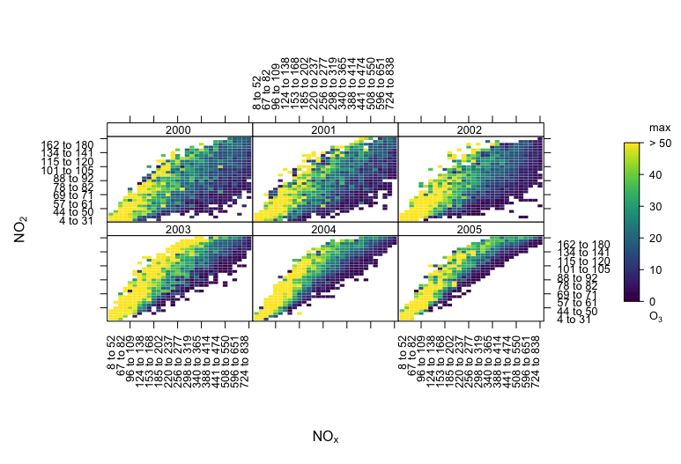
Trend Level Heat Map Examples

Slide 36
Calendar Plot
Uses (and Sources):
Plots the pollutant level directly onto a calendar for clear temporal viewing of peak days.
Data Columns Required:
Pollutant (e.g., pm10)
Time/Date (date)
Other factors
Ws
Wd
Other pollutant

Slide 37
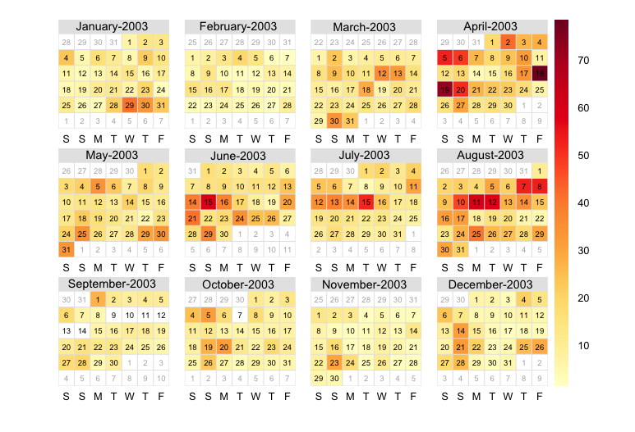
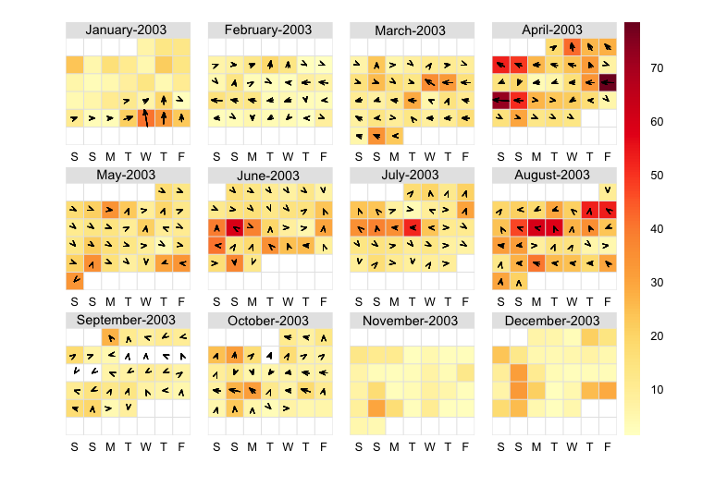
Calendar Plot Examples

Slide 38
Theil-Sen Trends
Uses (and Sources):
A different type of regression averaging: slope is taken between every pair of two points. This is resistant to non-normal data with a non-constant variance, and to outliers. Solid line is Theil-Sen Estimate and Dashed Lines are 95% CI.
Data Columns Required:
Pollutant (e.g., pm10)
Time/Date (date)
Other factors
Ws
Wd
Other pollutant

Slide 39
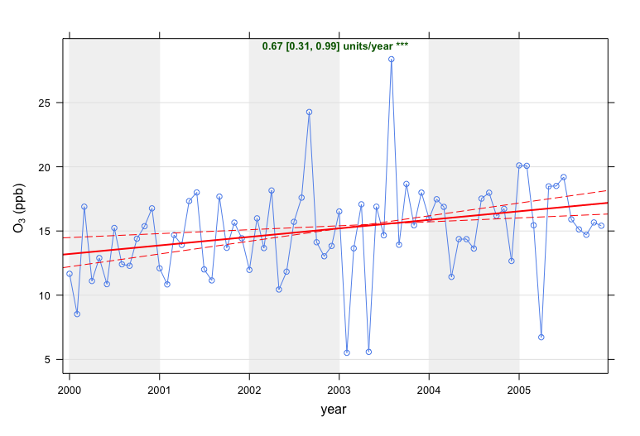
Theil-Sen Examples

Slide 40
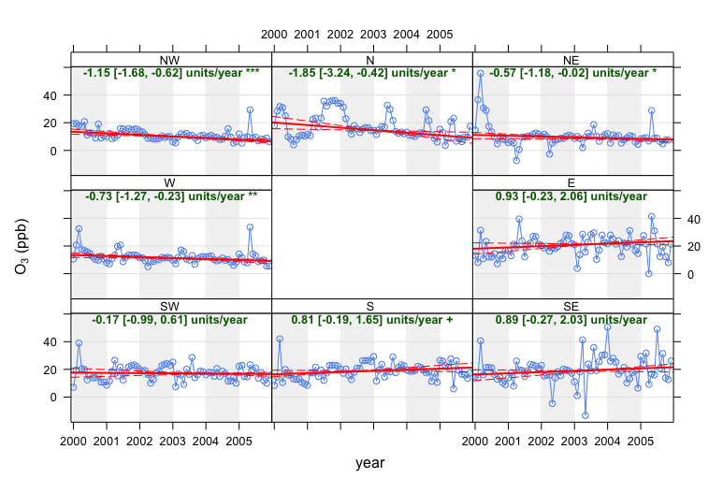
Theil-Sen Examples

Slide 41
Smooth Trend
Uses (and Sources):
Another trend type with 95% CI. It is often optimized to include important data but also be quite smooth. This won't necessarily be a straight line! Data can be deseasonalized to remove large impacts of monthly averages.
Data Columns Required:
Pollutant (e.g., pm10)
Time/Date (date)
Other factors
Ws
Wd
Other pollutant

Slide 42
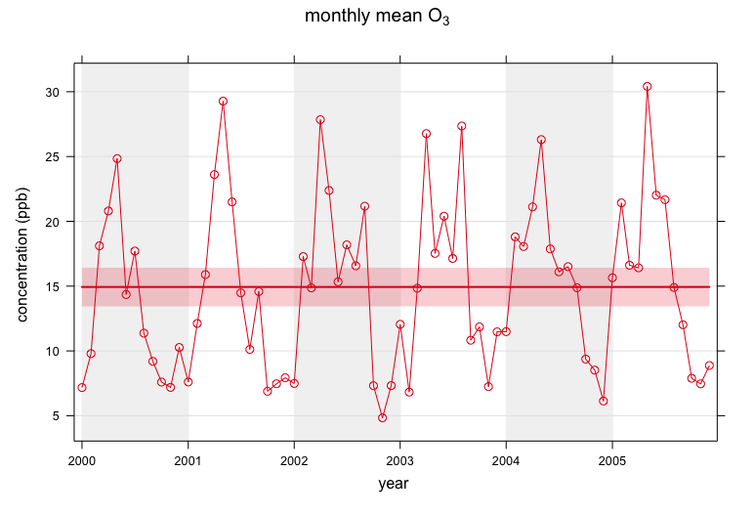
Smooth Trend Examples

Slide 43
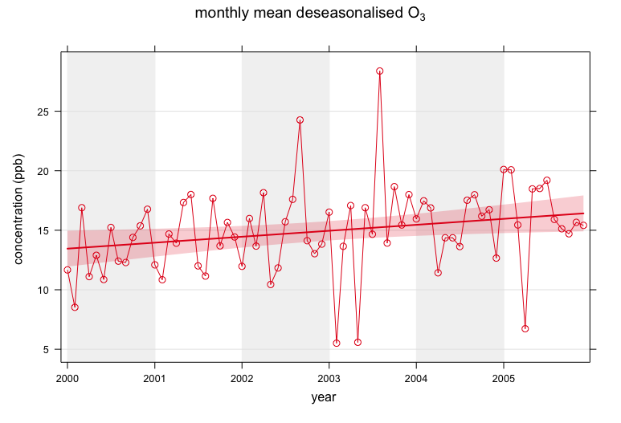
Smooth Trend Examples

Slide 44
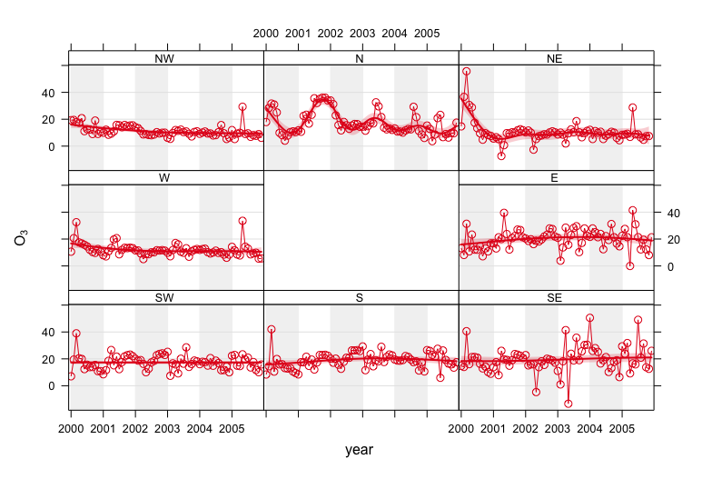
Smooth Trend Examples

Slide 45
Scatter Plots
Uses (and Sources):
A basic data visualization tool for comparing two continuous variables. Can be made more complex through binning, formatting, and adding/making trends, etc.
Data Columns Required:
2 Pollutants (e.g, no2 and nox)
Other factors

Slide 46
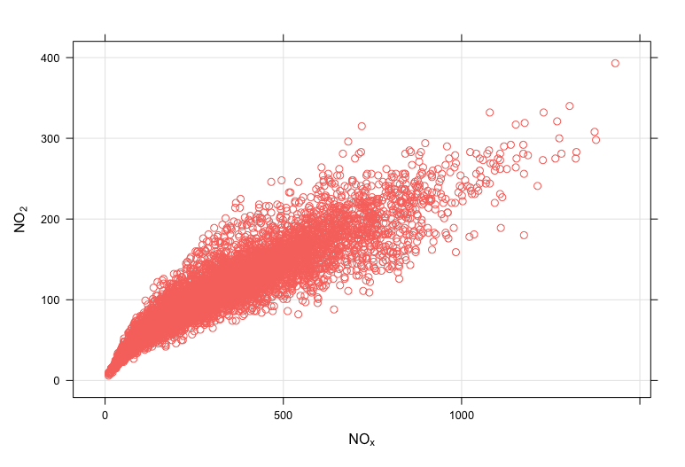
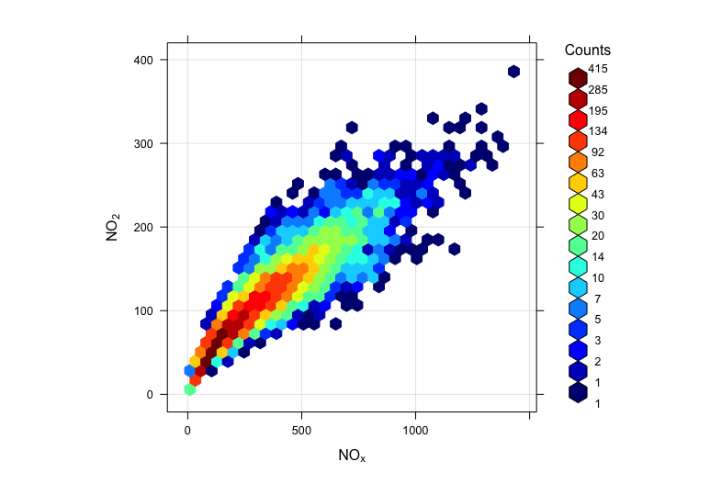
Scatter Plot Examples

Slide 47
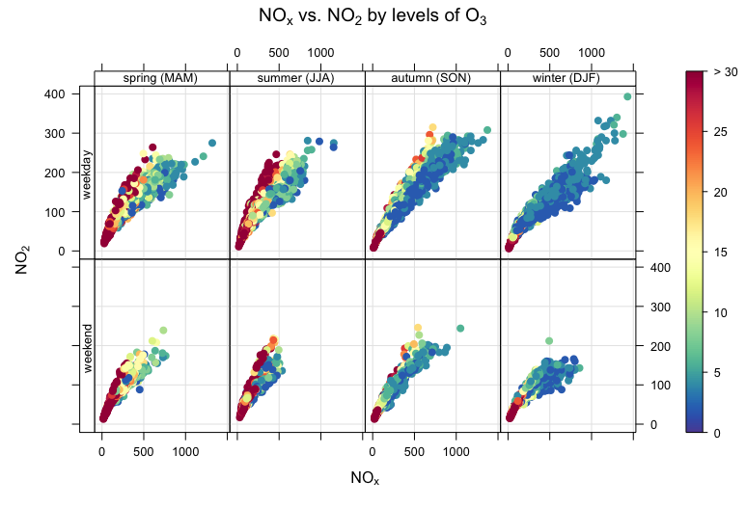
Scatter Plot Examples

